Slide 1
Lecture 9
Topics
Glitches and Hazards
Hazard Types (Function, Logic), (Static, Dynamic)
Recognizing Static Logic Hazards
Correcting Static Logic Hazards
Types of Functions and Delays
Trivial, Simple, 1- and 2- and Multilevel Gate Circuits
Decoders and Multiplexers

Slide 2
Glitches and Hazards
Notes:
Note: even gates on the same IC will not have exactly identical propagation delays and then of course there are different “wire”/trace path lengths.

Slide 3
Glitches and Hazards
Glitch: Momentary error condition on the output of a circuit due to unequal signal delay paths. Manifestation of a hazard.
Function Hazard: May cause glitch when two or more inputs change at once. Cannot be removed by adding logic.
Logic Hazard: May cause glitch when one input changes. Can be removed by adding logic.
Dynamic Hazard: Occurs when output of the circuit is changing.
Static Hazard: Occurs when output of the circuit is constant.
Function and Logic Hazards can be Static or Dynamic.
Note: even gates on the same IC will not have exactly identical propagation delays and then of course there are different “wire”/trace path lengths.

Slide 4
Static Logic Hazards
Single input changed.
Resulting output should have remained the same:
1 in case(a), 0 in case(b).
However, a glitch appeared before the output settled back to its correct level.
In two-level SOP circuits may see static 1 hazards
In two-level POS circuits may see static 0 hazards

Slide 5
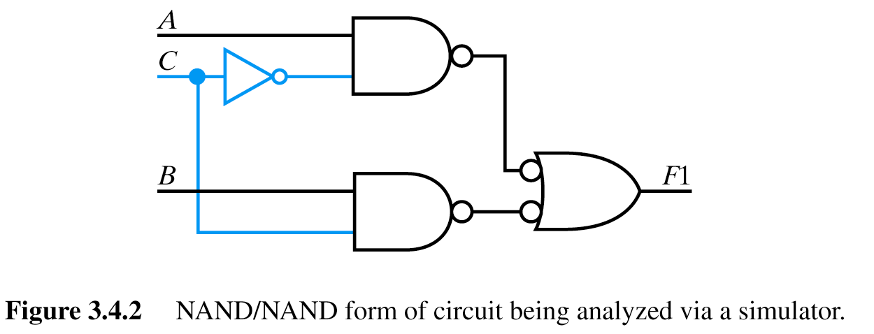
Static Logic Hazards
Consider inputs
ABC
111
110
1
1
1
0
0
1
1
1
1
0
0
NAND/NAND Implementation

Slide 6
Static Logic Hazards
Consider inputs
ABC
111
110
1
1
1
0
0
1
1
1
1
0
0
NAND/NAND Implementation
Let’s look in detail at how a static logic hazard might arise, how it would manifest itself as a glitch and what you can do about it.
Mention simulation
Also mention that the glitch may not make a difference – synchronous design which you’ll learn later (for now, just know that we may only “look” at the output after a certain “settling” time.

Slide 7
Detecting and Eliminating Static Logic Hazards
Chain Link Rule

Slide 8
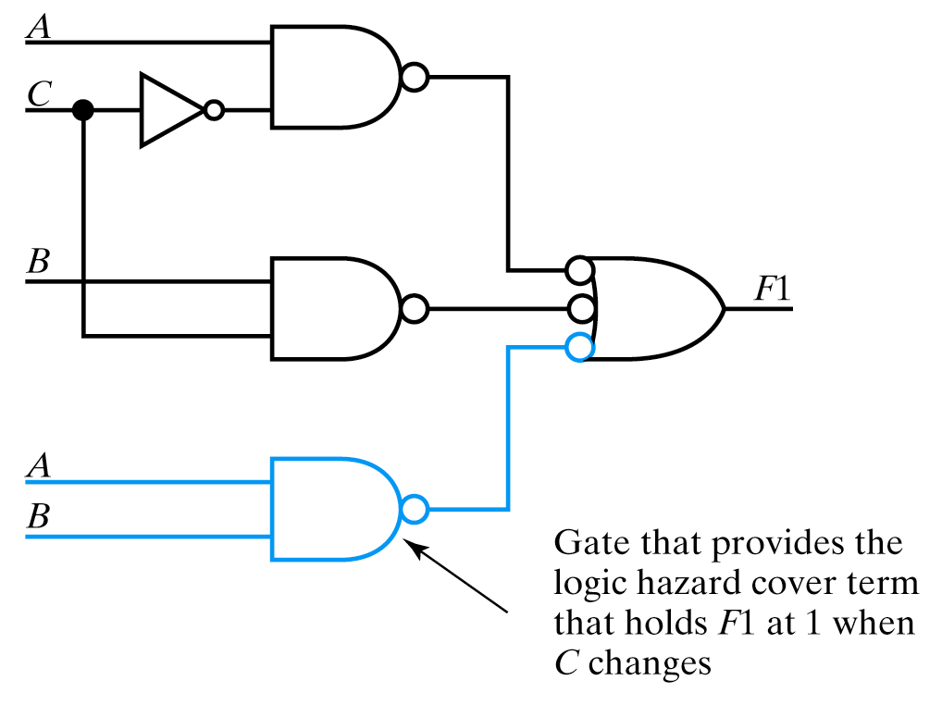
Detecting and Eliminating Static Logic Hazards

Slide 9
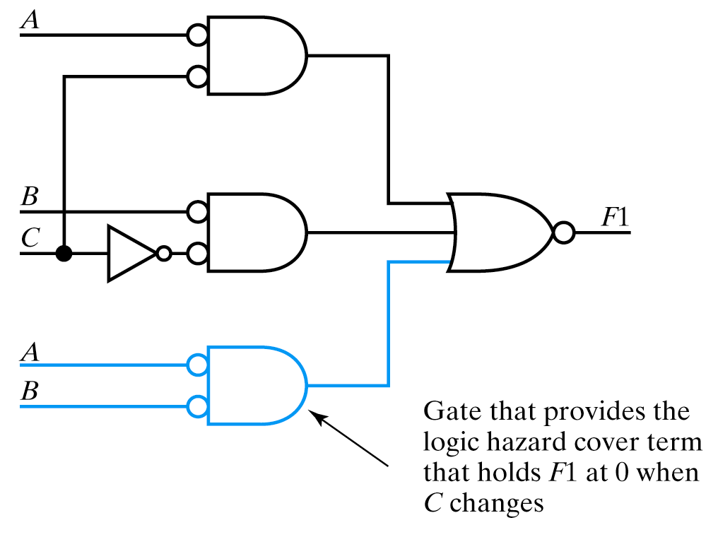
Another Example
Implement a hazard-free circuit for the 0s of the previous function using NOR gates
SOP Form for 0s
Need Cover Term

Slide 10
Static Function Hazards
Result of two or more input signals changing
Cannot be removed by adding logic

Slide 11
Dynamic Hazards
Generally occur in multi-level circuits when there are multiples paths with different delays from an input to an output.
Do not occur in 2-level SOP (or POS) implementations.

Slide 12
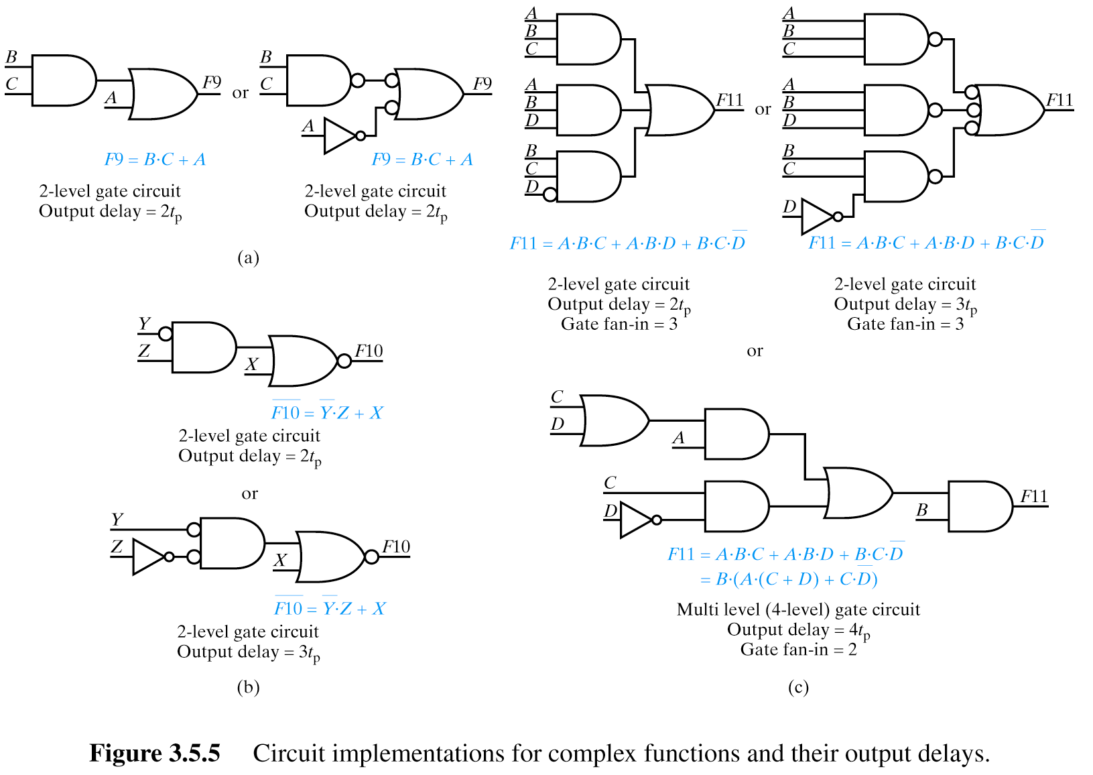
Implementations for Complex Functions and Their Delays

Slide 13
Decoders

Slide 14
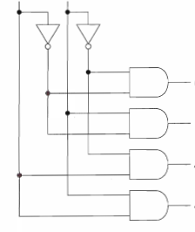
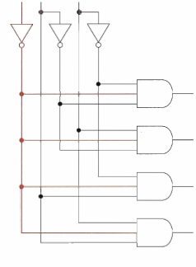
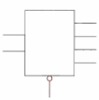
Decoders
n-to-2^{n} decoder
Converts binary code on input lines to one of 2^{n} output lines
I1
I0
Y0
Y1
When a decoder has an EN (enable) input it’s often called a demultiplexer (dmux). EN is often active low.
Y2
Y3
EN
I1
I0
I1
Y0
Y1
Y0
I0
Y2
Y3
Y1
EN
Y2
Y3

Slide 15
Decoders
Sometimes outputs are active low too!
B₁B₀ F₀F₁F₂F₃
0 0 0 1 1 1
0 1 1 0 1 1
1 0 1 1 0 1
1 1 1 1 1 0

Slide 16
Decoders as Universal Function Implementers
Outputs are minterms
I1
I0
Any function can be expressed in canonical SOP form
Y0 (m₀)
Y1 (m₁)
Y2 (m₂)
Y3 (m₃)

Slide 17
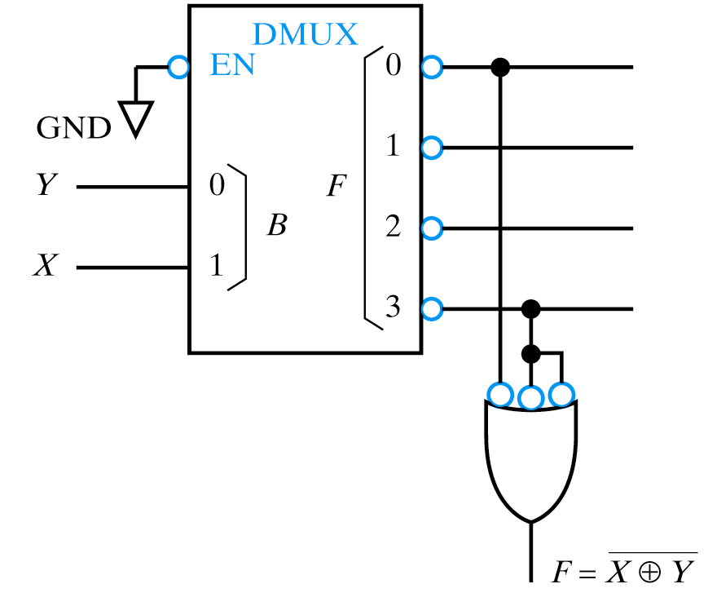
Decoders
When using decoders with active low outputs use “bubble matching” to use correct gate
Example: Implement XNOR with DMUX

Slide 18
Multiplexers

Slide 19
Multiplexers (Data Selectors) Mux
Directs one of 2^{n} inputs to a single output
S₀ F
0 D₀
1 D₁
S₀D₁D₀ F
0 0 0 0
0 0 1 1
0 1 0 0
0 1 1 1
1 0 0 0
1 0 1 0
1 1 0 1
1 1 1 1

Slide 20
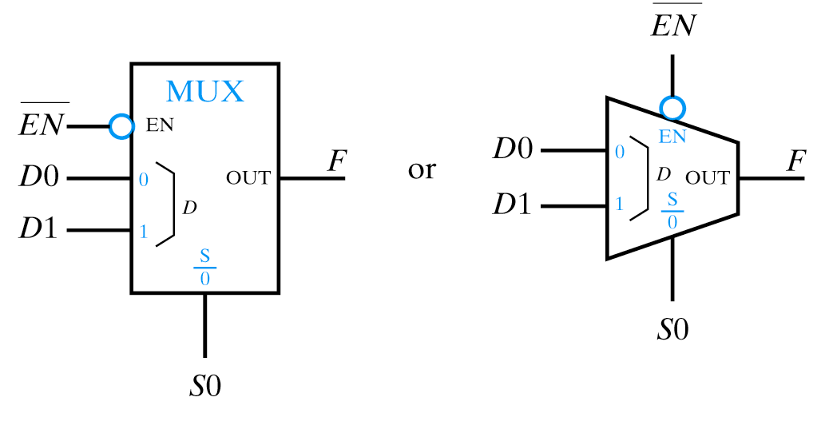
Multiplexers
Sometimes include Enable input
Effective as universal function generator
EN S₀ F
0 0 D₀
0 1 D₁
1 X 0
Just as decoders were effective as minterm generators (simple functions) and could be used in combination with an OR (NAND) gate to generate functions, a Mux can be used to generate complex functoin

Slide 21
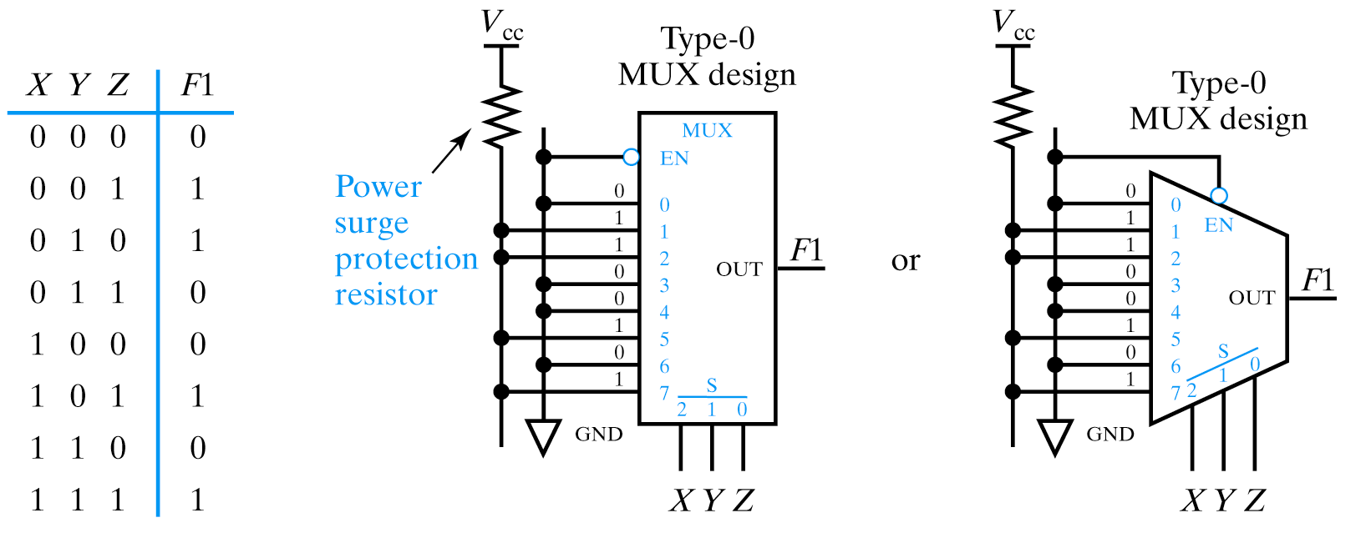
Type 0 Universal Function Implementation with a Mux
Uses the function inputs (X,Y,Z) to “select” the value of the function by selecting the minterm corresponding to the inputs. If the minterm m_{i} is in the function the corresponding D_{i} input is tied to 1 (0 otherwise)

Slide 22
Type 1 Universal Function Implementation with a Mux

Slide 23
A word about “optimization”
What are we optimizing?
Variables (inputs – connectors)
Terms (gates, interconnect)
Unique fan-in (IC packages – same number of gates)
Number of logic levels (speed)
NAND/NOR Implementations (speed, IC packages,…)
Complexity (Design time – time to market)
Design Time & Flexibility/Cost (FPGA vs. ASIC)

Slide 24
Sources
Prof. Mark G. Faust
John Wakerly

